Slide 1
Insecurity of Voice Solution VoLTE in LTE Mobile Networks
Chi-Yu Li, Guan-Hua Tu, etc.
University of California, Los Angeles
CCS ‘15 Proceedings of the 22nd ACM SIGSAC Conference on Computer and Communications Security, Pages 316-327
Notes:
此範本可作為群組設定中簡報訓練教材的起始檔案。
章節
在投影片上按一下右鍵以新增章節。 章節可協助您組織投影片，或簡化多個作者之間的共同作業。
備忘稿
使用 [備忘稿] 章節記錄交付備忘稿，或提供其他詳細資料給對象。 於簡報期間在 [簡報檢視] 中檢視這些備忘稿。
請記住字型大小 (對於協助工具、可見度、影片拍攝及線上生產非常重要)
協調的色彩
請特別注意圖形、圖表及文字方塊。
考慮出席者將以黑白或 灰階列印。執行測試列印，以確保在進行純黑白及 灰階列印時色彩正確。
圖形、表格和圖表
保持簡單: 如果可能，使用一致而不令人分心的樣式和色彩。
所有圖表和表格都加上標籤。

Slide 2
OUTLINE
INTRODUCTION
NEW SECURITY ISSUES WHEN VOLTE TURNS VOICE INTO “DATA”
PERPETRATING MOBILE DATA SERVICE IN VOLTE CONTROL PLANE
MUTING VOICE THROUGH SPAMS IN VOLTE DATA PLANE
RECOMMENDED FIX
DISCUSSION
RELATED WORK
UPDATE
CONCLUSION
Notes:
提供簡報的簡短概觀。 描描述簡報的主要焦點與其重要性。
介紹每個主要主題。
為了幫助簡報對象掌握簡報重點，您 可以 在整個簡報期間重複此概觀投影片，反白顯示您接下來要討論的特定主題。

Slide 3
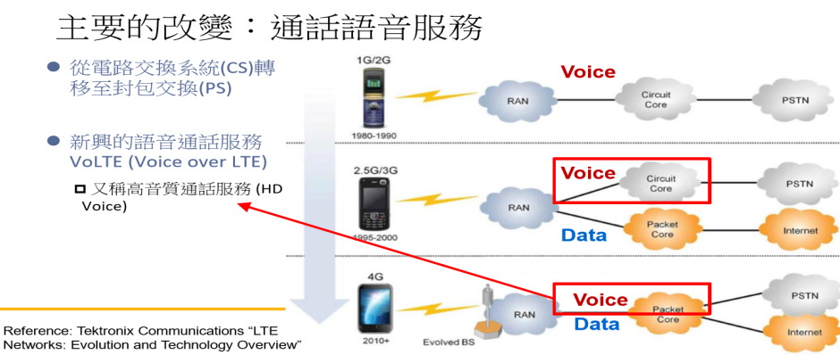
INTRODUCTION
4G VoLTE: Voice-over-IP (VoIP) scheme, packet-switched (PS)-only, all-IP based LTE network .
Notes:
這是另一個選項 適用於使用轉換的概觀投影片。

Slide 4
INTRODUCTION
Advantages: Carrier-grade quality, high-priority, quality-of-service(QoS).
Problems:
Loopholes.
Open the door to run data over VoLTE. (Threats in hardware, OS and mobile apps)
Side-channel to leak critical information.
Notes:
這是另一個選項 適用於使用轉換的概觀投影片。

Slide 5
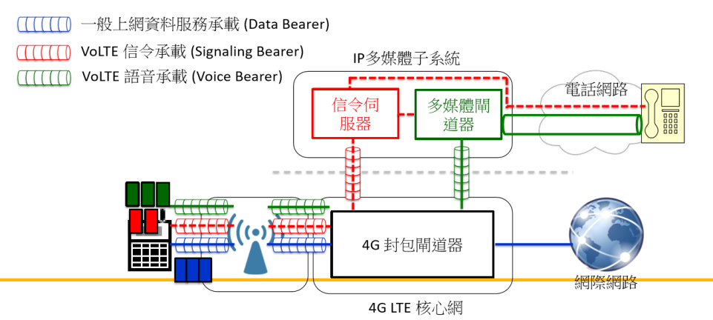
NEW SECURITY ISSUES WHEN VOLTE TURNS VOICE INTO “DATA”
VoLTE network architecture and how it works?
Reference: :Chi-Yu Li, “Potential Risk in 4G mobile network.”
Notes:
這是另一個選項 適用於使用轉換的概觀投影片。

Slide 6
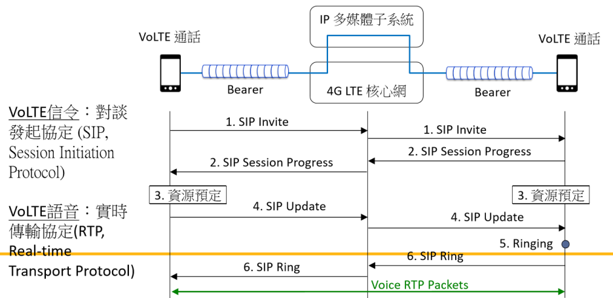

NEW SECURITY ISSUES WHEN VOLTE TURNS VOICE INTO “DATA”
VoLTE network architecture and how it works?
Notes:
這是另一個選項 適用於使用轉換的概觀投影片。

Slide 7
NEW SECURITY ISSUES WHEN VOLTE TURNS VOICE INTO “DATA”
Potential Vulnerabilities:
Can trick VoLTE to gain PS data access, despite its designated role for voice?
Can learn private, critical information on voice calls from VoLTE?
Will the voice-related policies and operations(e.g., voice billing and QoS control) work well in the VoLTE context?
Notes:
這是另一個選項 適用於使用轉換的概觀投影片。

Slide 8
NEW SECURITY ISSUES WHEN VOLTE TURNS VOICE INTO “DATA”
Attack Model and Methodology:
Attacker: a mobile user.
Victims:
Network operator (two top-tier US carriers)
Other mobile users (Samsung Galaxy S5 and LG G3).
OS: Android 4.4.2 and 4.4.4.
Notes:
這是另一個選項 適用於使用轉換的概觀投影片。

Slide 9
PERPETRATING MOBILE DATA SERVICE IN VOLTE CONTROL PLANE
Carrying Data In VoLTE Signaling:
VoLTE signaling bearer can be exploited to carry mobile data service.
Two vulnerabilities:
Device side: no access control to prevent non VoLTE packets from being injected into the signaling bearer.
Network side: injected packets are allowed to pass by. (routed to the destination by the 4G gateway)
Notes:
這是另一個選項 適用於使用轉換的概觀投影片。

Slide 10
PERPETRATING MOBILE DATA SERVICE IN VOLTE CONTROL PLANE
Carrying Data In VoLTE Signaling:
Lack of Access Control at Phone Software & Hardware-手機上沒有適當的存取控制
在Android作業系統上(2015)，對於VoLTE信令承載(網路介面)沒有適當的權限控制.
行動軟體傳送封包至信令承載，只需擁有 Android上的網際網路權限 (Internet permission).
手機硬體上，也沒有存取控制.
Notes:
這是另一個選項 適用於使用轉換的概觀投影片。

Slide 11
PERPETRATING MOBILE DATA SERVICE IN VOLTE CONTROL PLANE
Carrying Data In VoLTE Signaling:
Imprudent Routing and Forwarding in the Network-網路上沒有適當的存取控制
網路中，對於VoLTE信令承載有不適當的路由。
案例:
T-Mobile: 手機到網際網路和另一手機。
AT&T: 手機到另一手機。
Notes:
這是另一個選項 適用於使用轉換的概觀投影片。

Slide 12
PERPETRATING MOBILE DATA SERVICE IN VOLTE CONTROL PLANE
Exploiting VoLTE for Free Data Access:
Abusing No Billing of VoLTE Signaling.
Any packets via VoLTE signaling bearer are free, no matter where the destination is.
作法:
Call every 15 secs, hang up before the call is answered, last 10 hours, deliver 42.4 MB comtrol messages. (No charge)
Send 5000 ICMP Echo Requests (each carrying 1KB) and receive 4914 ICMP Echo Replies. The trafﬁc is about 10MB (both uplink and downlink). (No charge)
Notes:
這是另一個選項 適用於使用轉換的概觀投影片。

Slide 13
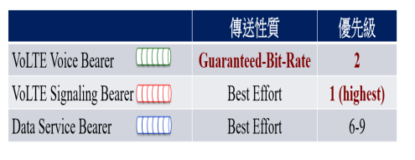
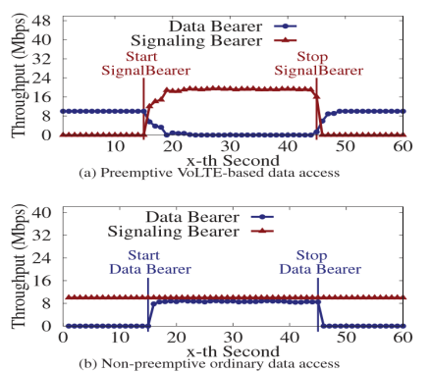
PERPETRATING MOBILE DATA SERVICE IN VOLTE CONTROL PLANE
ManipulatingDataAccessPriority:
Abusing high QoS of VoLTE Signaling.
VoLTE: Guarantee high quality voices.
Without prudent trafﬁc ﬁltering, it likely becomes an incentive for the adversary to exploit VoLTE.
Notes:
這是另一個選項 適用於使用轉換的概觀投影片。

Slide 14
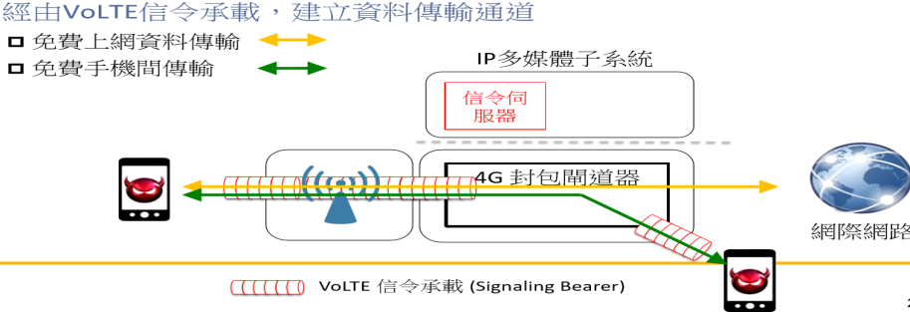
PERPETRATING MOBILE DATA SERVICE IN VOLTE CONTROL PLANE
Proof-of-concept Attacks:
Free-data attack.
攻擊者：行動用戶; 受害者：行動網路
驗證攻擊的美國電信商：AT&T、T-Mobile和Verizon
Notes:
這是另一個選項 適用於使用轉換的概觀投影片。

Slide 15
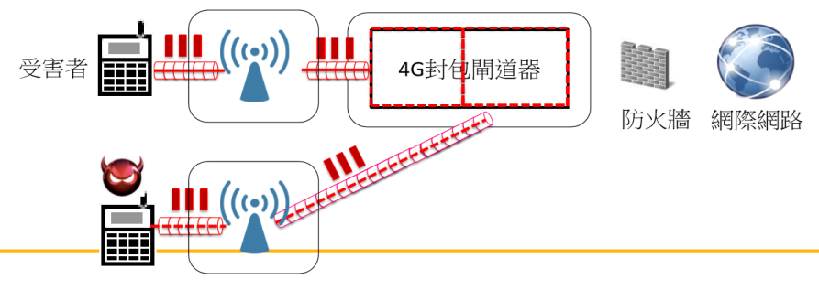
PERPETRATING MOBILE DATA SERVICE IN VOLTE CONTROL PLANE
Proof-of-concept Attacks:
Data DoS Attack.
經由高優先等級VoLTE信令承載，傳送大量垃圾封包 (Spamming) 
Notes:
這是另一個選項 適用於使用轉換的概觀投影片。

Slide 16
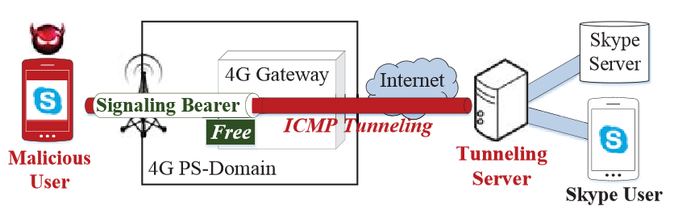
PERPETRATING MOBILE DATA SERVICE IN VOLTE CONTROL PLANE
Attacks on Real Apps:
Free Skype service over mobile network.
Notes:
這是另一個選項 適用於使用轉換的概觀投影片。

Slide 17
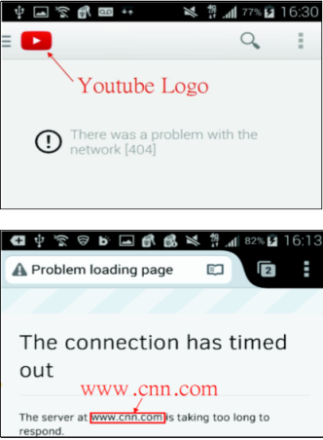
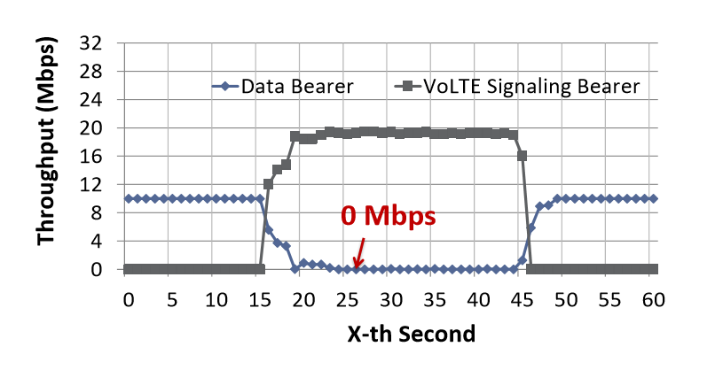
PERPETRATING MOBILE DATA SERVICE IN VOLTE CONTROL PLANE
Attacks on Real Apps:
Data DoS on Web browser and Youtube.
Notes:
這是另一個選項 適用於使用轉換的概觀投影片。

Slide 18
MUTING VOICE THROUGH SPAMS IN VOLTE DATA PLANE
Injecting Packets into the Voice Bearer:
Insufﬁcient Data–Plane Access Defense at Phone.
An app without root privilege can inject high-rate trafﬁc into the voice bearer.
Data packets created by the unprivileged app has been successfully injected into the voice bearer.
The injected trafﬁc indeed overﬂows the uplink buffer of the voice bearer at the callee, with most voice packets being discarded.
Notes:
這是另一個選項 適用於使用轉換的概觀投影片。

Slide 19
MUTING VOICE THROUGH SPAMS IN VOLTE DATA PLANE
Injecting Packets into the Voice Bearer:
Side-channel Leakage of Session Privacy.
The ID of each RTP session is a session secret. (carried by VoLTE signaling messages and encrypted)
Two factors may trespass session privacy:
The voice session ID are delivered to the voice bearer, and others to the signaling bearer.
Resource reservation for the voice bearer is not affected by the signaling bearer.
QoS is good for performance but can be bad for privacy.
Notes:
這是另一個選項 適用於使用轉換的概觀投影片。

Slide 20
MUTING VOICE THROUGH SPAMS IN VOLTE DATA PLANE
Leakagein Coordination between Planes:
Side-channel Leakage by Improper Coordination.
The session ID can also be leaked from improper coordination between planes. It can be obtained during call set up and call termination.
When voice packets are forwarded to the signaling bearer, they reach the phone’s VoLTE interface. Once captured by non-VoLTE apps, they can leak the session ID.
Notes:
這是另一個選項 適用於使用轉換的概觀投影片。

Slide 21
MUTING VOICE THROUGH SPAMS IN VOLTE DATA PLANE
Voice-Muted DoS Attack-語音拒絕服務攻擊
攻擊者：惡意軟體
受害者：行動用戶
驗證攻擊的美國電信商：AT&T和T-Mobile
驗證攻擊的手機廠商：Samsung和Sharp (都使用Qualcomm的modem chipset)
不同以往對於語音通話的攻擊方式
以前：無法建立通話
現在：雖可建立通話，但雙方無法聽到對方的聲音
Notes:
這是另一個選項 適用於使用轉換的概觀投影片。

Slide 22
RECOMMENDED FIX
Network-side solution:
4G gateway enforces strict routing regulation for each bearer.
Operators stop free-signaling policy and charges signals similar to data trafﬁc.
DoS attacks: ensure resource allocation to authentic trafﬁc only.
Notes:
這是另一個選項 適用於使用轉換的概觀投影片。

Slide 23
RECOMMENDED FIX
Device-side solution:
the mobile OS should build a VoLTE permission that only allows the dialer app to access the VoLTE interface.
the chipset enforces stringent access control.
Best rule: When it works as PS data, it should be treated as PS data.
Notes:
這是另一個選項 適用於使用轉換的概觀投影片。

Slide 24
DISCUSSION
Bugs in early deployment?
Symptoms of incomplete transition?
Blaming operators?
Incentives.
Notes:
這是另一個選項 適用於使用轉換的概觀投影片。

Slide 25
UPDATE
Fixed: All data-relevant attacks. (including free data attack, overbilling, preemptive data and data DoS attacks)
Will be fixed: Voice DoS attack.
Notes:
這是另一個選項 適用於使用轉換的概觀投影片。

Slide 26
RELATED WORK
Related studies:
Model the threat issues of the IMS.
Caller ID spooﬁng or SIP message spooﬁng to launch DoS/DDoS attacks.
Mobile network security.
Overcharging attacks, DoS attacks by overloading the control channel for SMS
User authentication loopholes, information leakage at ﬁrewalls
Next Topic: Mobile malware, malware infection. (DoS attacks require a malware without root permission)
Notes:
這是另一個選項 適用於使用轉換的概觀投影片。

Slide 27
CONCLUSION
VoLTE is at early phase for global rollout ansd it suffer from easy-to-ﬁx mistakes during this period.
Security solutions need efforts form the network infrastructure, the end host and the device.
Voice service and voice threats are double-edged issues.
Notes:
這是另一個選項 適用於使用轉換的概觀投影片。

